Slide 1
Amazon Product Review Analysis
Dashboard Insights Summary (2009–2012)

Slide 2
Top Performing Categories
• Electronics leads in product count, reviews, and revenue
• Home & Kitchen and Computers & Accessories follow
• Strong customer engagement and high profitability

Slide 3
Discount Strategy & Consumer Behavior
• Home Improvement and Computers & Accessories have highest discounts
• 751 products have ≥50% discount
• Negative correlation (-0.15) between discount and ratings

Slide 4
Customer Sentiment & Ratings
• Top-rated products (e.g., REDTECH, Amazon Basics) score 5.0 stars
• Strong candidates for upselling or featured campaigns

Slide 5
Low Engagement Risk
• 1,465 products have <1000 reviews
• Suggest rebranding, remarketing, or delisting to optimize ROI

Slide 6
Pricing & Value Perception
• Majority products priced >₹500
• Discounts influence customer choices, but may hurt perceived quality

Slide 8
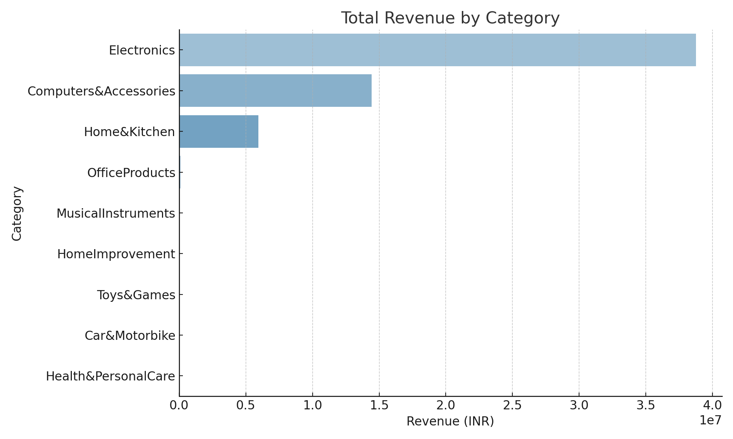
Total Revenue by Category

Slide 9
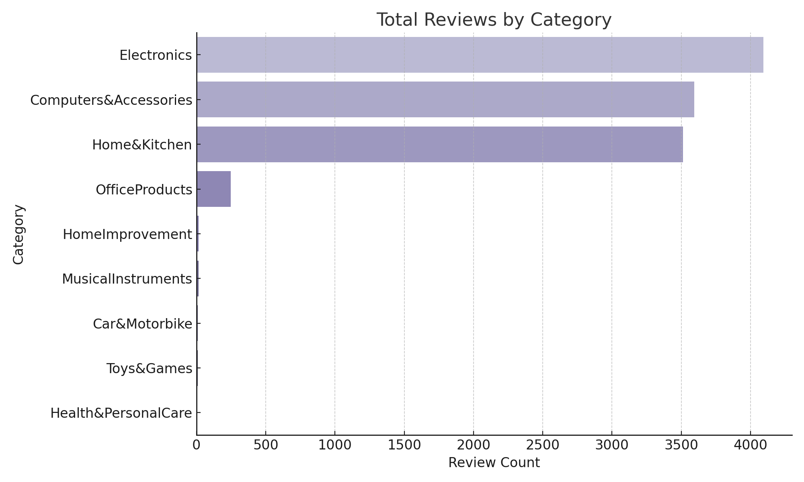
Total Reviews by Category

Slide 10
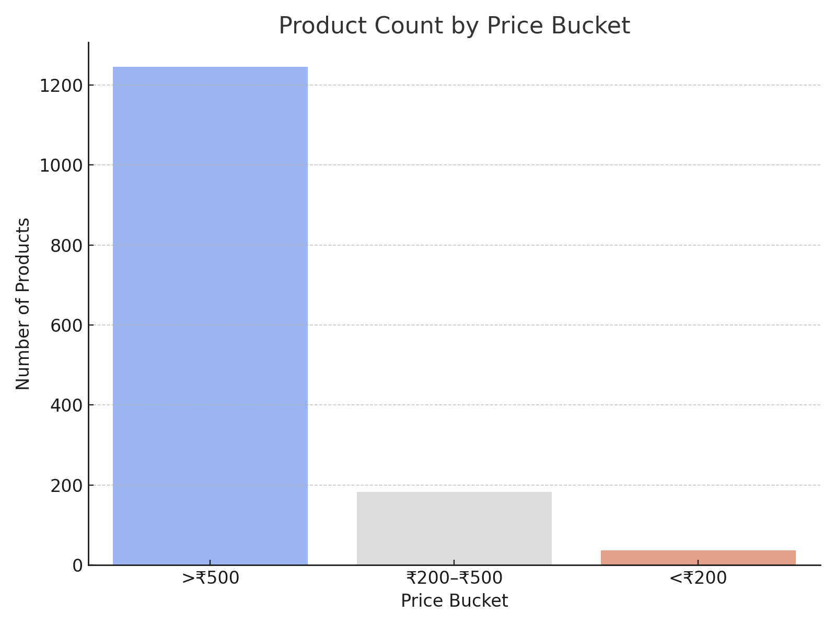
Product Count by Price Bucket

